Slide 1
r/place Analysis: Humans v Bots
Part 2: Bigger & Better and slower
Eva Murdock, Alexa Hildebrand, Fernando Fonseca

Slide 2
Conducting a Bot Witch Hunt
01
Parquet File
02
The Witch Hunt
03
Visualizations
Created locally and uploaded to AWS S3 Bucket (mistake)
Run Sagemaker script that filters out non-bots
Fun fact: campus wifi’s uploading power is 100x stronger than Alexa’s house
Create visualizations of bot activity in Sagemaker
Notes:
Due to memory constraints in sagemaker, split up our files into smaller chunks by saving subsequently smaller parquets and csv
Big parquet created locally
Uploaded to S3
Connected to sage maker
Created little parquet by shortening encrypted userID to unique identifier (went from 12 GB to 2 GB) and creating time diff between pixel placement by users
From there it was small enough to read in as pandas df
Used csv to save memory

Slide 3
Cracking the Bot code
If a user places pixels at least every 21 minutes for at least 16 hours, they are a bot
Notes:
https://economictimes.indiatimes.com/news/international/us/reddit-launches-2023-edition-of-r/place-what-is-it-and-why-are-redditors-posting-against-steve-huffman-heres-all-you-need-to-know/articleshow/101995639.cms?from=mdr
20 mins for unverified user
16 hours is wake period
(16*60) /21 = 45

Slide 4
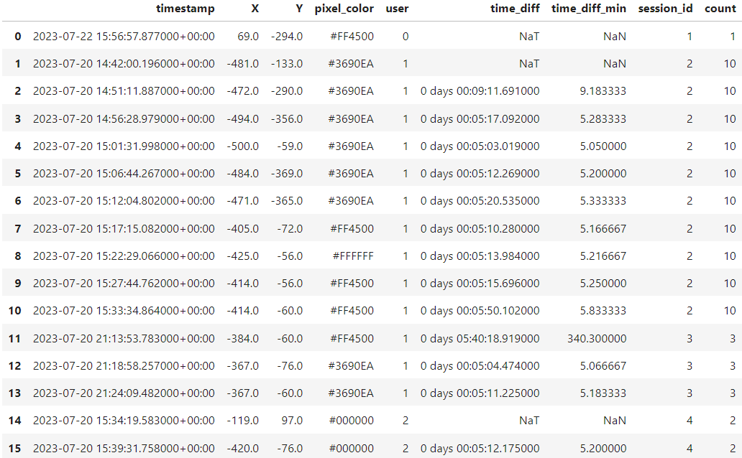
Attack Plan:
Our Blueprint to Combat Bots
A new session is created when it has been longer than 21 mins or it is a new user
Count: number of pixels placed in a session
SessionID changes because time_diff >21
Notes:
Created a function that assign session id to each row, then we calculated total time for each session by taking the first entry of the session timestamp minus the last entry for that session and getting those sessions that were longer than 16 hours.

Slide 5
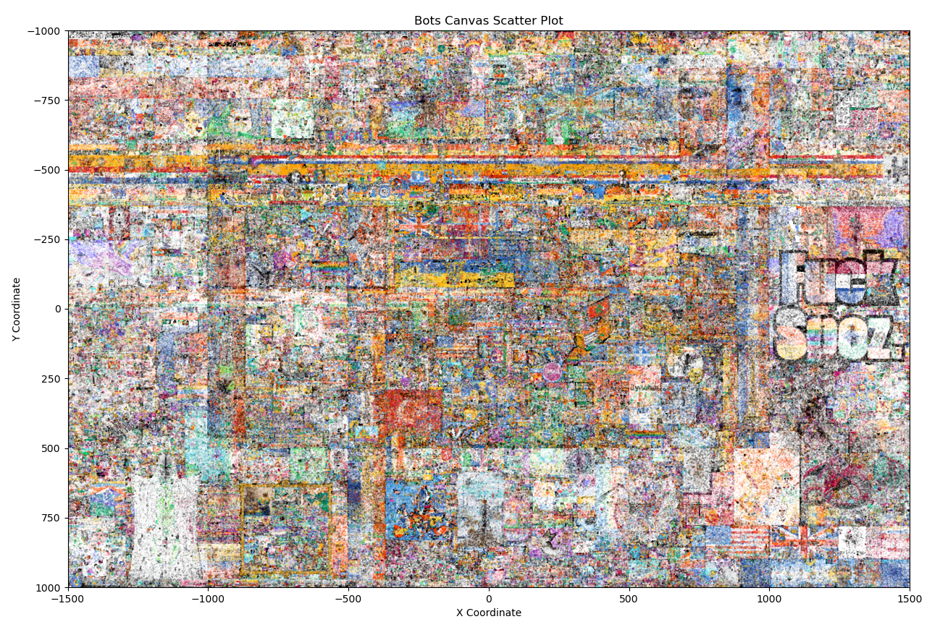
Bot work: the 'Picass-NOs' of r/place

Slide 6
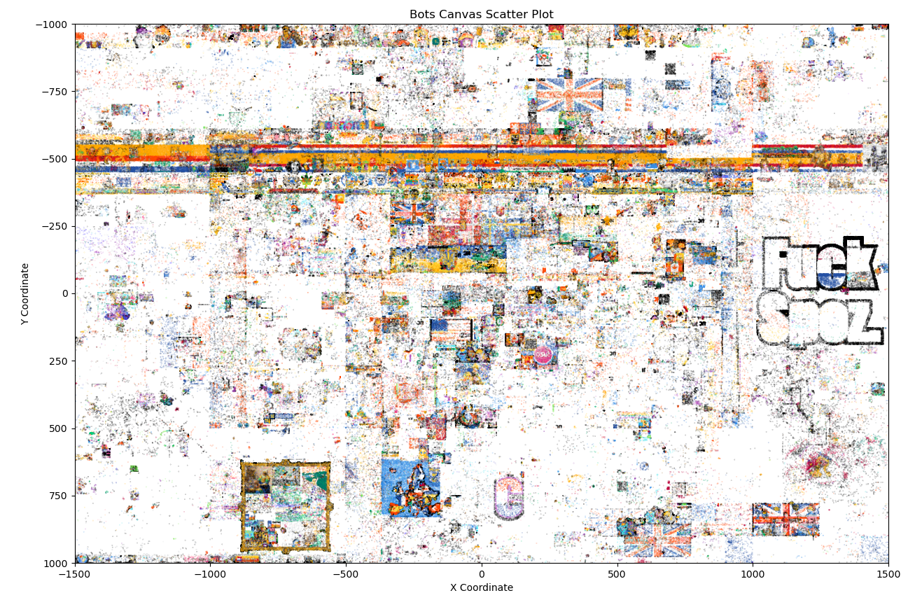
Bot work:the 'Picass-NOs' of r/place continued
Notes:
Unverified users
Filtered greater than 16 hours

Slide 7
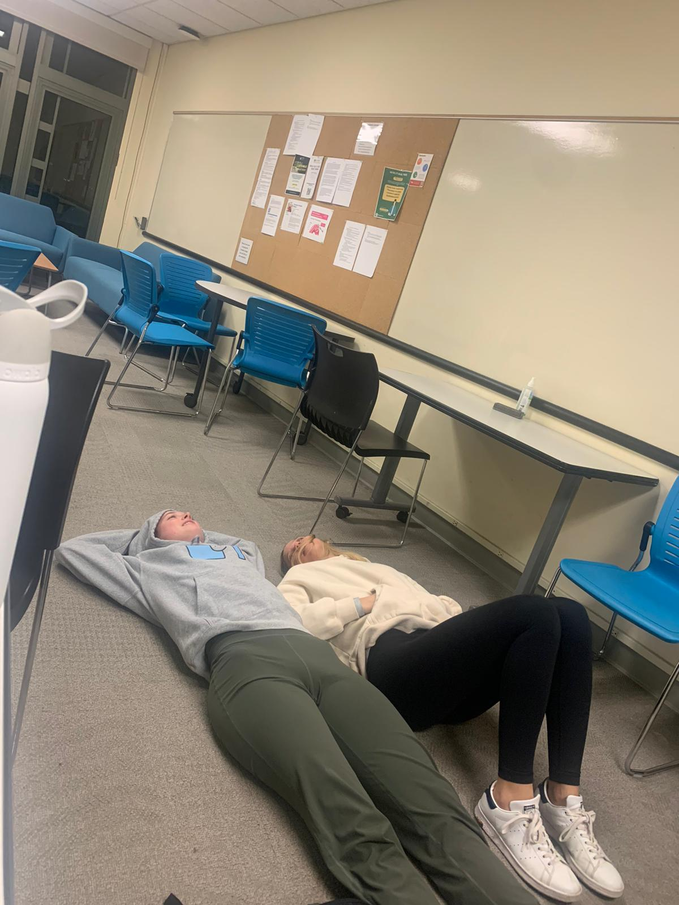
10 pm Grad Lounge - Bots Win
Questions?

